Slide 1
Association Patterns &Findings
-Million Songs-
_Jesserina_

Slide 2
Outline
Association Rules
Support & Confidence settings
Association rules first glance and problems
Keep interesting words
Revised Association patterns
Visualizing association rules
Basic idea of recommendation system
Cluster Analysis
Topic models
LDA
Notes:
.

Slide 3
Association Rules: Support & confidence settings
Definition of Association Rules
What is the Rule?
If LHS (Antecedent) ={ I_1, I_2, I_3….I_m}, then RHS(Consequent)={I_k}.
How to select interesting rules?
Support&Confidence

Slide 4
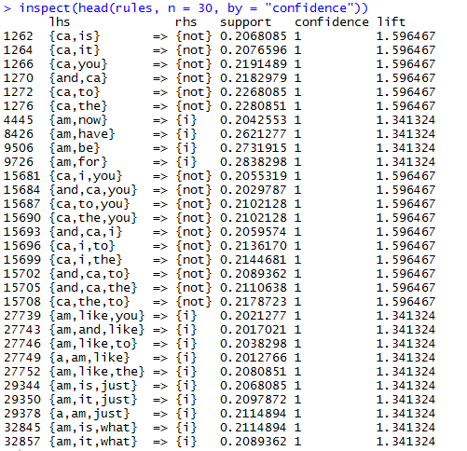
Association Rules: Support(=0.2) & Look at the rules, there is a problem that, We can find there are too many very common words like ‘ca’, ‘is’, ‘it’. The words seem meaningless to us, as we want to find association rules among some featured words. confidence(=0.6)

Slide 5
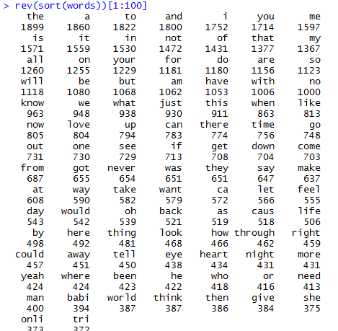
Keep interesting words
The frequency of words:

Slide 6
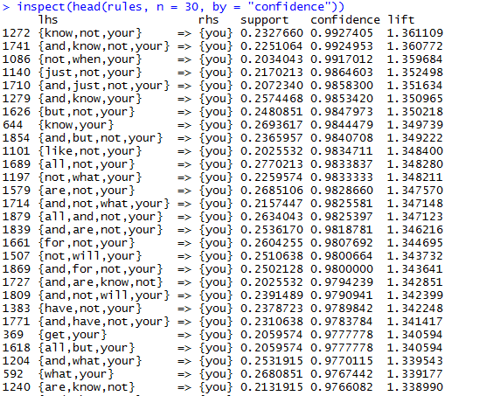
Revised Association Patterns

Slide 7
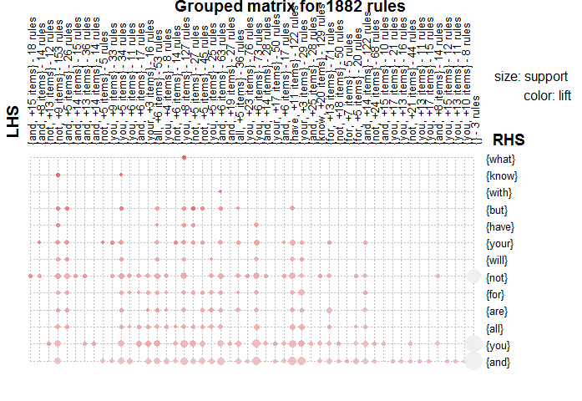
Visualizing association rules

Slide 8
Basic idea of recommendation system
Train 1 Train 2 …..
Word1 word 2 ..word 5000
New 1
New 2
…….
…….
…….
New 100
Word1 word 2 ..word 5000
Train 1
Train 2
…….
…….
…….
Train 2350
New 1
New 2
…….
…….
…….
New 100
X
=
100 x 2350
Similarities matrix
2350 x 5000
Known song-dictionary
matrix
100 x 5000
New song – dictionary
matrix
Notes:
Here is the basic idea of my recommendation system:
since we want to find the association between the new 100 songs and the 5000 dictionary words.
We can use this two thousand three hundred fifty songs as latent factor, then connect new songs and this old set of songs using distance based similarities.
It is a dimension of 100*two thousand three hundred fifty matrix, and then we can multiply it by this known song-words matrix(which is a known connection).
This works since we find similarities between the training songs and the testing songs, then we continue to find the dictionary words in the training data set.
here we use all of the training songs with weights based on similarities.

Slide 9
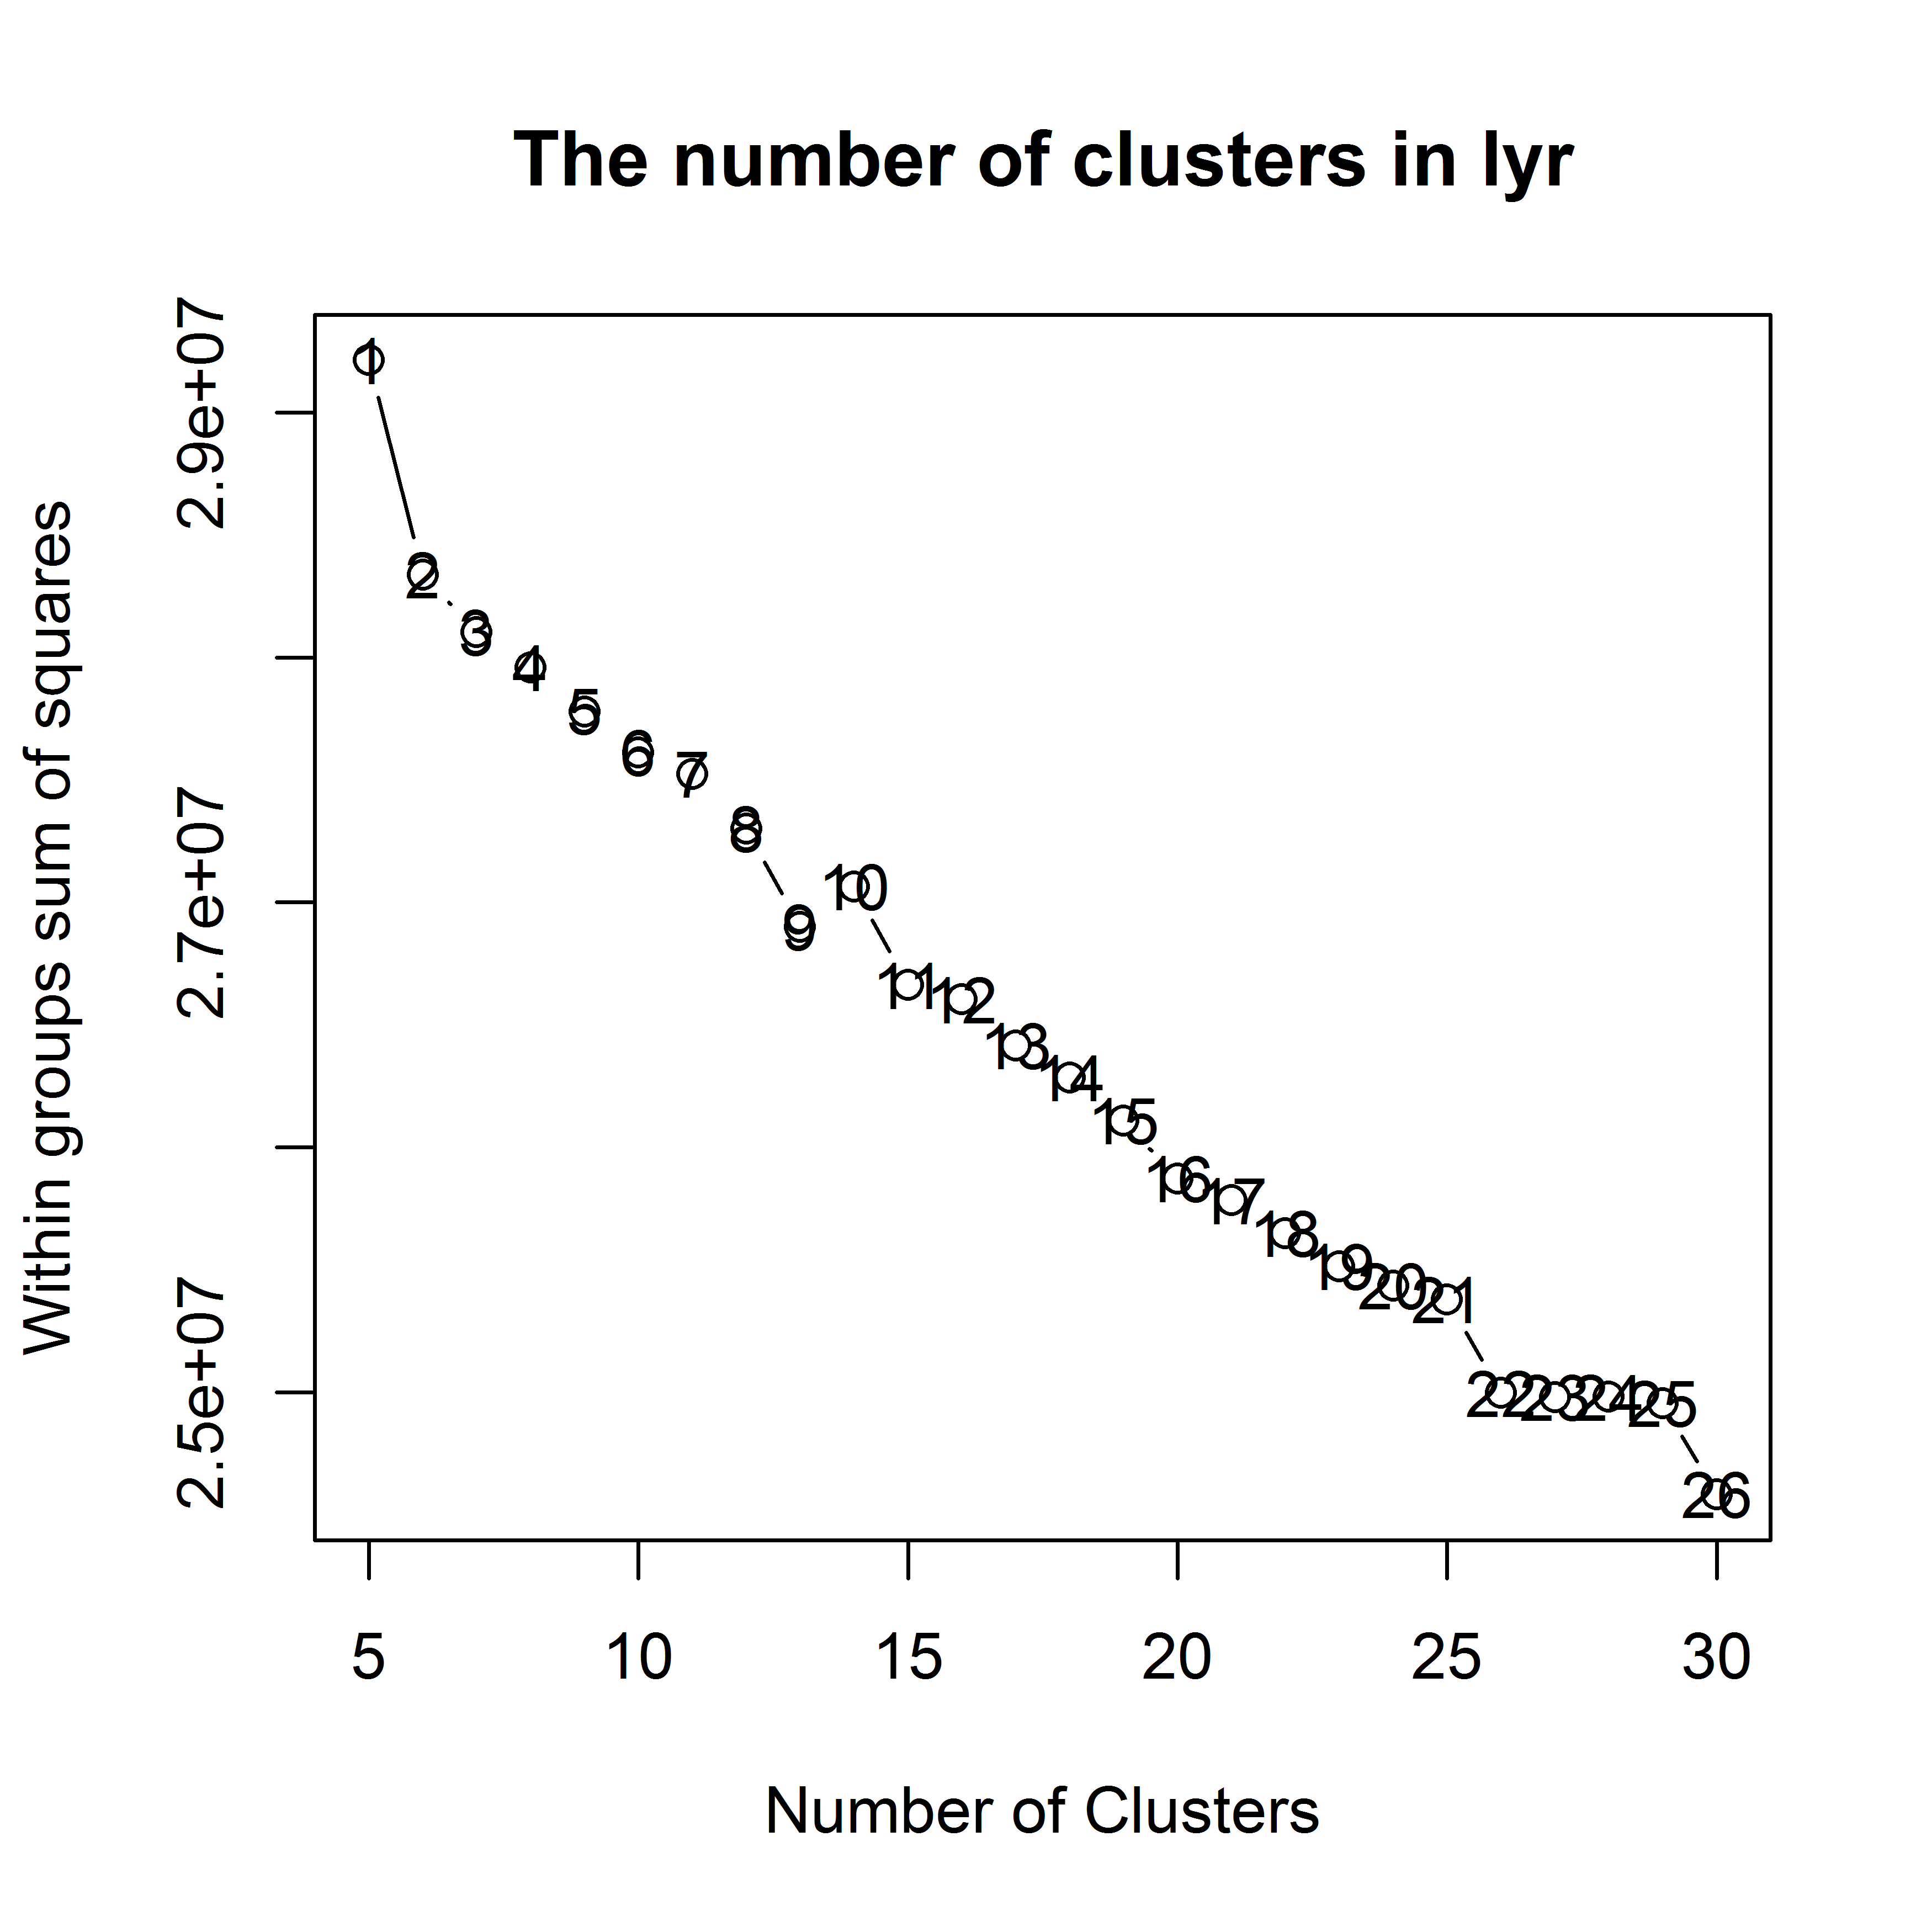
Cluster Analysis
Cluster numbers
From the figure left, the 22~25 clusters are Suitable for the MSD dataset.

Slide 10
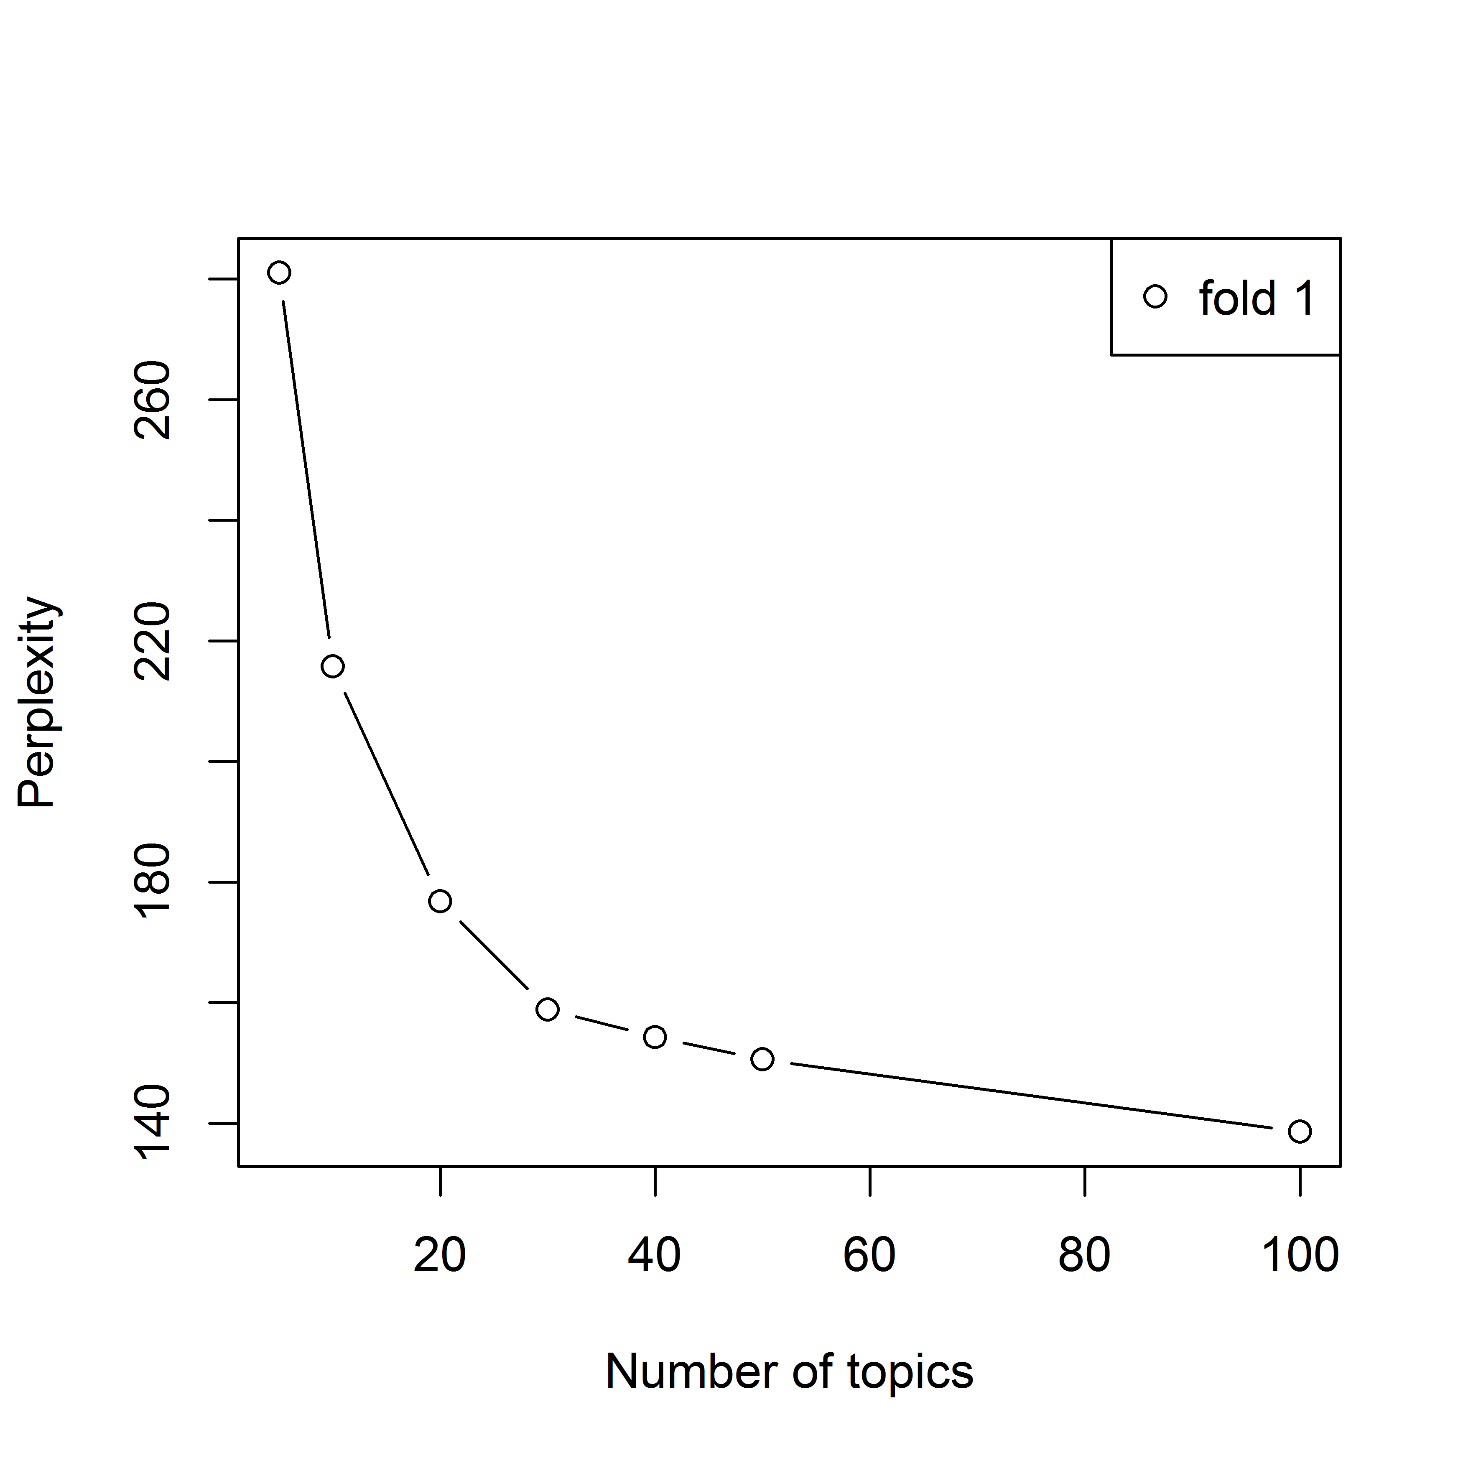
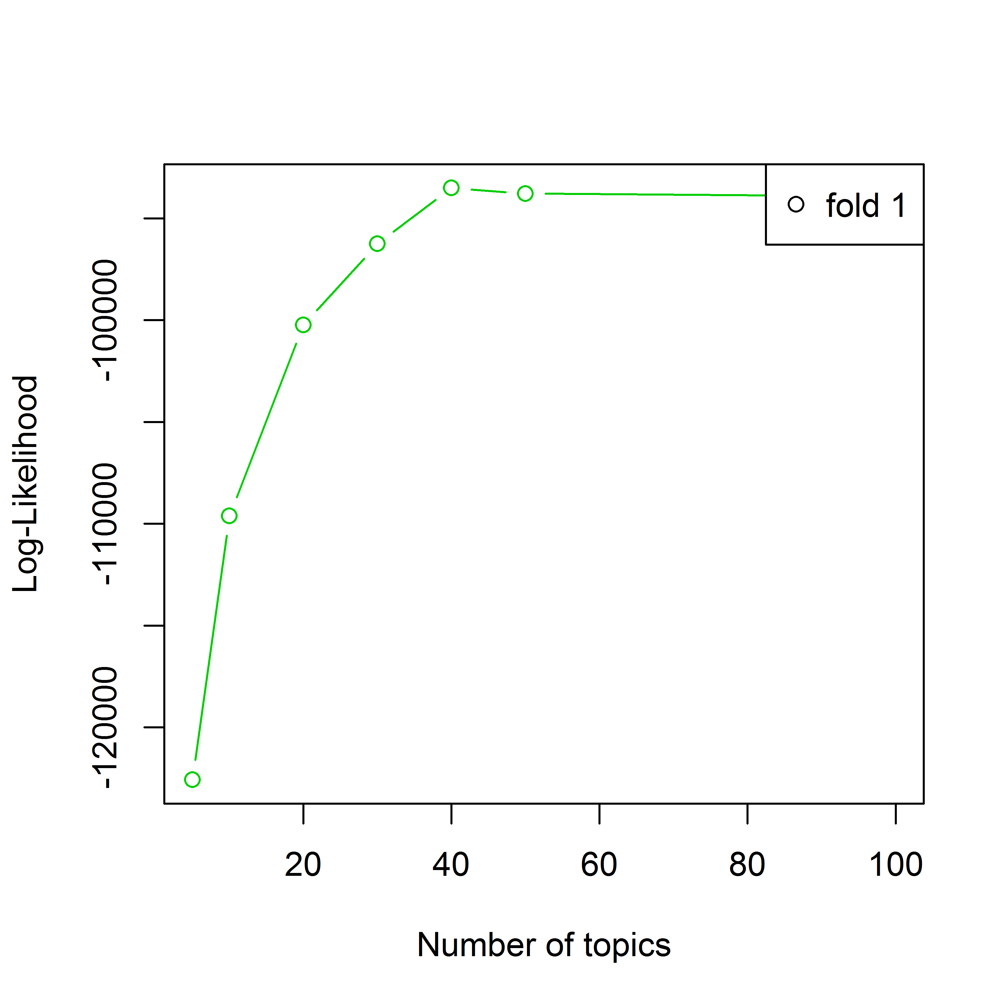
Topic Models: choose topic k

Slide 11
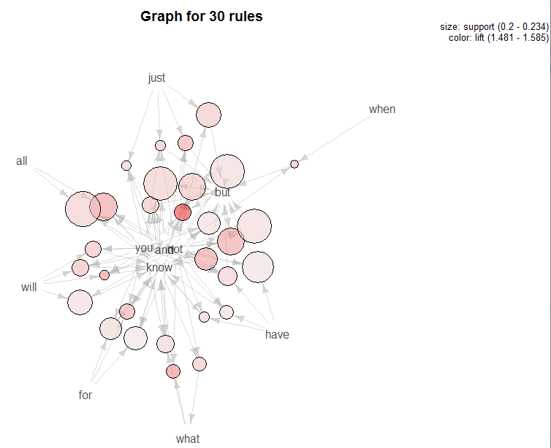

Topic Models-Algorithm
LDA_VEM
LDA_VEM_FIXED
LDA_GIBBS
CTM

Slide 12

Thank you!
Notes:
Ok. That ends my presentation on exploration and findings of the MSD dataset. Thank you.

